Slide 1

Mini Project 3
Shrey Parekh
Notes:
Photos by Freepik

Slide 2
Humans response to death by tumor
An analysis performed to determine brain tumor from images.
Notes:
Photos by Freepik

Slide 3
Agenda
01
06
Preprocessing
Background
Context on the business objective
Cleaning the data, Imputation of the data
02
07
Model
Business objective
Describe the problem statement
Convential Nueral Networks VG19
Evaluation
03
Data Pipeline
08
Results
Describes the wrangling and transformation of data
04
Data Exploration
09
Summary
Data
Visualizations
Conclusion, Limitation and
Next steps.

Slide 4

Data Science Pipeline
Data Acquisition
Preprocessing
Evaluation
Next Steps
1
2
3
4
5
6
7
Data Exploration and
Visualization
Model
CNN and TF
Results

Slide 5
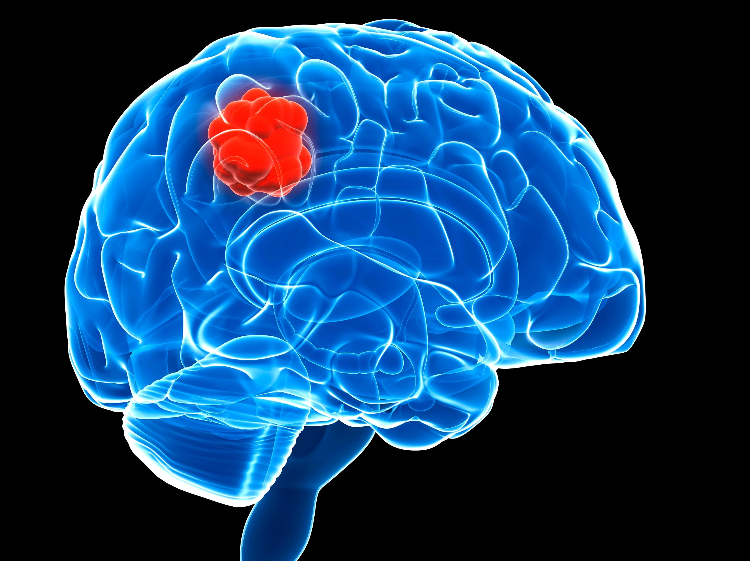
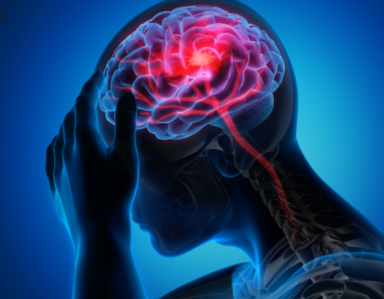
Background
Context
Brain Tumors are complex due to abnormalities in sizes and locations in the brain.
This makes it difficult in understanding the tumors natures.
A professional neurosurgeon is required for MRI analysis.
In developing countries there is lack of doctors and knowledge so an automated system on cloud can solve problem.
Notes:
Photos by Evening_tao / Freepik

Slide 6
Business Question
How to detect and classify brain tumor images into classes?
Can we predict accurately the classes of the 4 tumors using deep learning algorithm and tensor flow?
Why Ask this Question?
This is important because tumor accounts for 85 to 90 percent of all CNS tumors.
Every year 11,700 people are diagnosed with a brain tumor.
With 5 year survival rate for people with cancerous brain tumor.
Notes:
Photos by Freepik

Slide 7

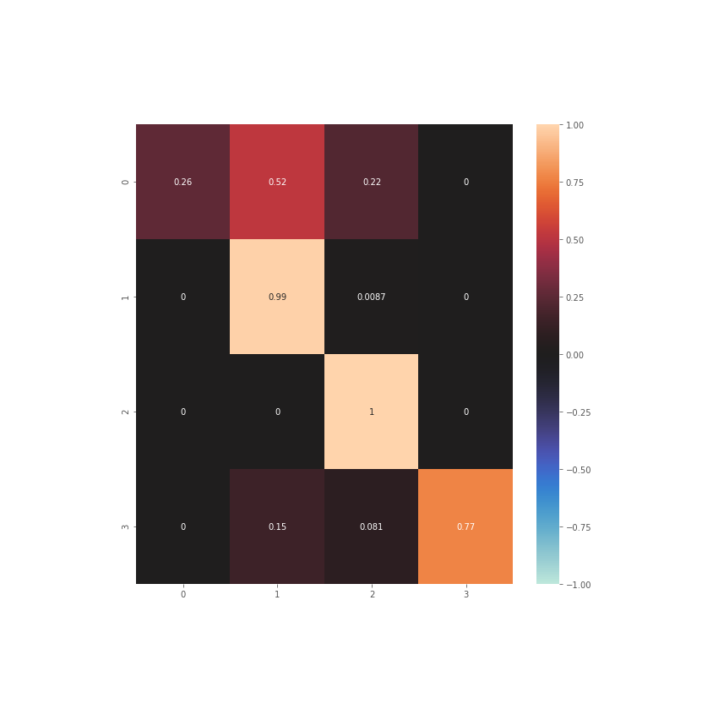
Data Set contains 3000images
Glioma
Meningioma
No tumor
Pituitary
Glioma
Meningioma
No tumor
Pituitary
Notes:
Photos by rawpixel.com / Freepik

Slide 8
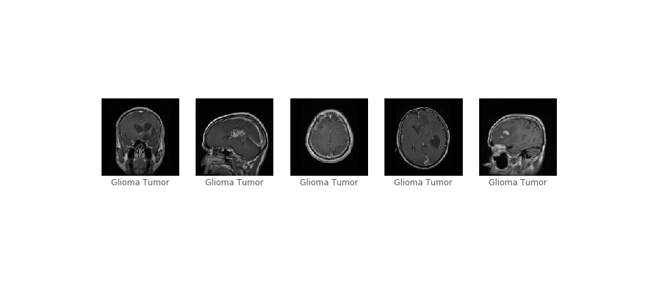
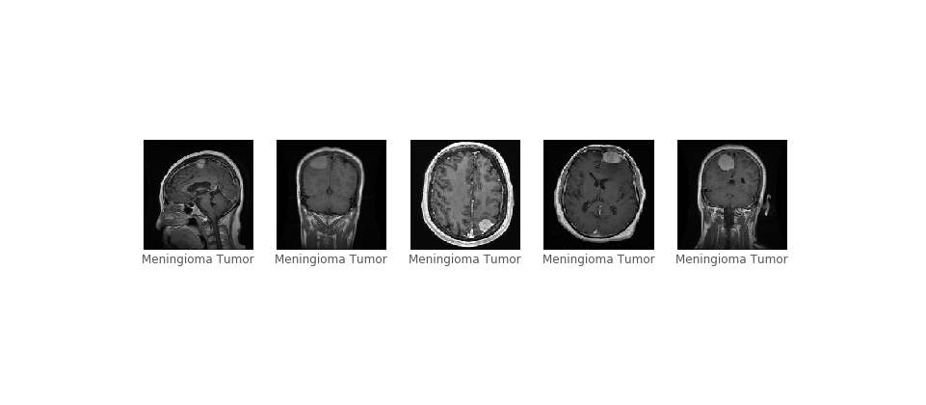
Data Exploration and Visualization
The plot shows images of Glioma Tumor and Meningioma Tumor

Slide 9
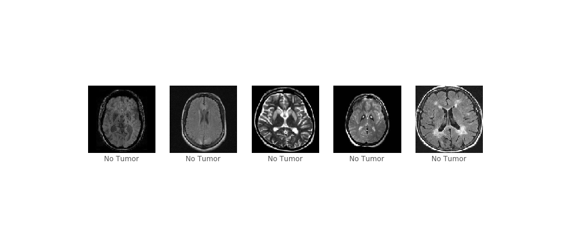
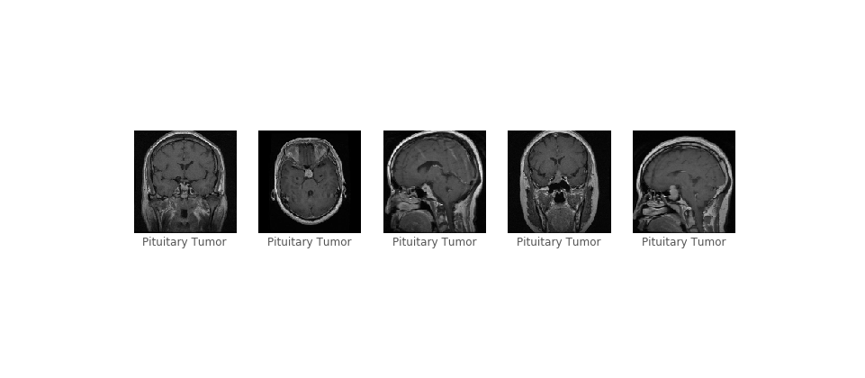
Data Exploration and Visualization
The plot shows images of No Tumor and Pituitary Tumor

Slide 10
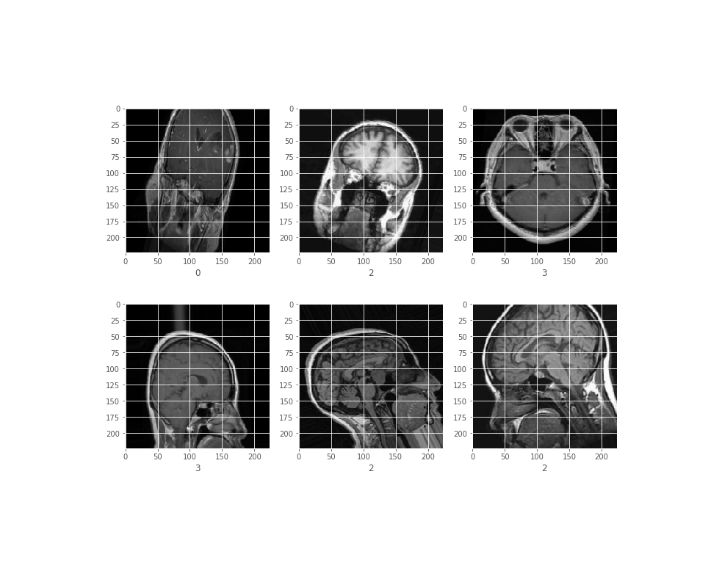
Preprocessing
The plot shows Preprocessed Images.
First Conducted Label Encoding transforming data
Into arrays to the 4 classes of tumor.
Then rescaled image 1./255

Slide 11
Model
VGG19
VGG19 is a variant of VGG model which in short consists of 19 layers ,16 convolution layers, 3 Fully connected layer, 5 MaxPool layers and 1 SoftMax layer.
The reason for choosing this model is because
It works best with large image data sets.
Notes:
Photos by Evening_tao / Freepik

Slide 12
Model
 | Results
Epoch 1 | Train on 2870 samples, validate on 394 samples Epoch 1/5 2870/2870 [==============================] - 2455s 855ms/step - loss: 0.6802 - accuracy: 0.7341 - val_loss: 1.3042 - val_accuracy: 0.5228
Epoch 2 | Epoch 00001: val_accuracy improved from -inf to 0.52284, saving model to effnet.h5 Epoch 2/5 2870/2870 [==============================] - 3413s 1s/step - loss: 0.2303 - accuracy: 0.9261 - val_loss: 1.1450 - val_accuracy: 0.6904
Epoch 3 | Epoch 00002: val_accuracy improved from 0.52284 to 0.69036, saving model to effnet.h5 Epoch 3/5 2870/2870 [==============================] - 3131s 1s/step - loss: 0.0997 - accuracy: 0.9728 - val_loss: 1.2586 - val_accuracy: 0.7234

Slide 13
Model
 | Results
Epoch 4 | Epoch 00003: val_accuracy improved from 0.69036 to 0.72335, saving model to effnet.h5 Epoch 4/5 2870/2870 [==============================] - 2679s 933ms/step - loss: 0.0467 - accuracy: 0.9906 - val_loss: 1.2848 - val_accuracy: 0.7563
Epoch 5 | Epoch 00004: val_accuracy improved from 0.72335 to 0.75635, saving model to effnet.h5 Epoch 5/5 2870/2870 [==============================] - 2772s 966ms/step - loss: 0.0275 - accuracy: 0.9927 - val_loss: 1.2354 - val_accuracy: 0.7665
Validation Accuracy | Epoch 00005: val_accuracy improved from 0.75635 to 0.76650, saving model to effnet.h5

Slide 14
Model Validation
 | Results
Validation Loss | Validation Loss: 1.2353701438508966
Validation Accuracy | 0.7664974331855774
Time | 394/394 [==============================] - 109s 277ms/step

Slide 15
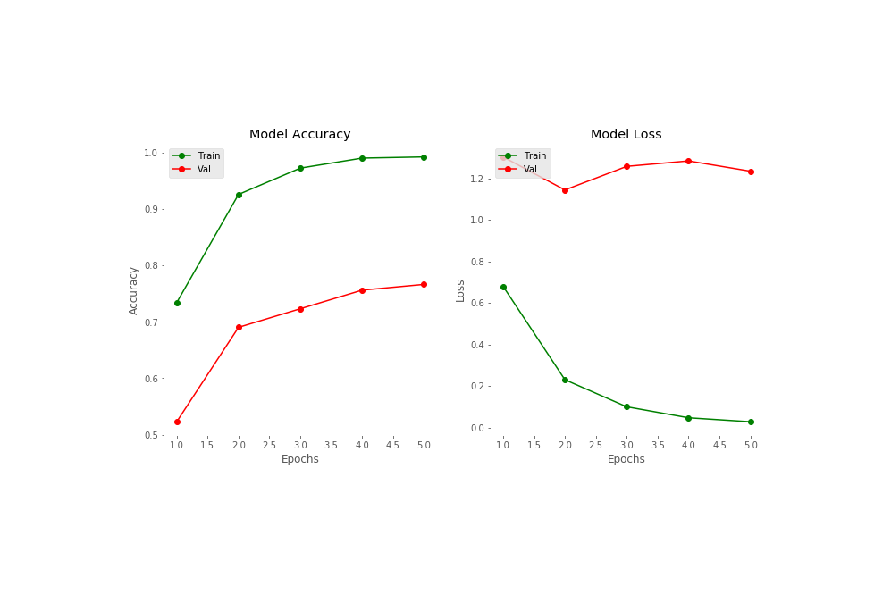
Model Evaluation

Slide 16
Results
 | Precision | Recall | Accuracy | Fl score
Glioma | 1.00 | 0.26 | 77 | 0.41
Meningioma | 0.64 | 0.99 | 77 | 0.78
No Tumor | 0.78 | 1.00 | 77 | 0.88
Pituatary | 1.00 | 0.77 | 77 | 0.87

Slide 17
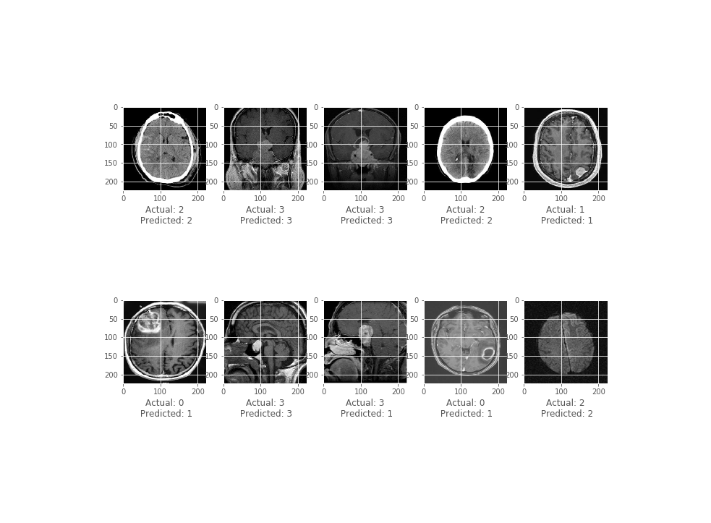
Results

Slide 18

Summary
We can conclude from our analysis that we are able to determine the classes of tumors with 77 percent Accuracy.
This demonstrates that the VG19 model is a good model to build conventional neural networks for this data set.
The limitations of the model is that VG19 requests a lot of memory. It takes 4-5 hours to conduct 5 epochs. So conducting 10 – 15 epoch’s will yield better result as the model was improving during each epoch but will take 12 hours .
The next steps would be experimenting with other models and parameters and choosing the best one as deep learning depends on the parameters chosen such as using Relu activation, optimization.
For future we can deploy this deep learning algorithm, model to IOS and Android through an application to detect tumors at home, anywhere remotely.
Notes:
Photos by creativeart / Freepik

Slide 19

THANK YOU
Notes:
Photos by Freepik

